Slide 1
Computer Networking

Slide 2
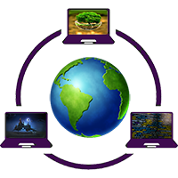
A computer network is a set of devices connected through links. A node can be computer, printer, or any other device capable of sending or receiving the data. The links connecting the nodes are known as communication channels.

Slide 3
Major Component of Computer Network
NIC
Cables and Connectors
Hub
Switch
Router

Slide 4
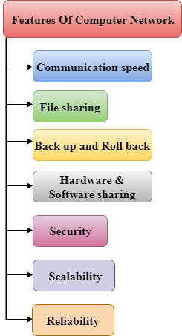
Features Of Computer network

Slide 5
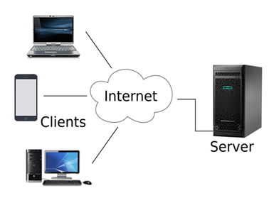
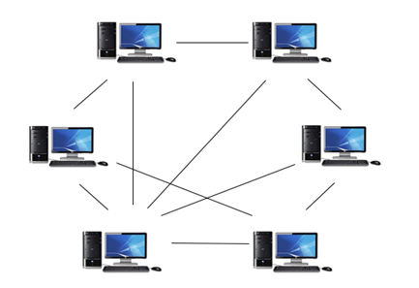
Computer Network Architecture
1. Peer-To-Peer network
2. Client/Server network

Slide 6
Network Topology
Bus Topology
Ring Topology
Star Topology
Mesh Topology

Slide 7
Network Transmission
1. Simplex mode
2. Half-duplex mode
3. Full-duplex mode

Slide 8
Thank You

